Slide 1

<anglular.io/>
Training Sessions

Slide 2
Agenda
JavaScript Ecosystem
Paradigm Shift
Angular Introduction
What is Angular
Architecture
Associated Frameworks
TypeScript
Angular Components

Slide 3

JavaScript Eco System -*
Build & Package Tool
MVC Framework
Server Side Framework
Grunt
Gulp
JSPM
WebPack
NPM Bower
Lite-Server
Mock-server
Layout Framework
JS Libraries
CSS Preprocessors
JS Languages (ECMA V5/6)
AngularJS
Angular.io
EmberJS
BackBone
ReactJS
Express
MongoDB
CommonJS
Hapi
UI Components
jQuery
Kendo UI
ExtJS
DOJO
SASS
Stylus
LESS
TypeScript
CofeeScript
DartLang
BootStrap
INK
Mueller
Skeleton
Google-MD
Testing Framework
Polymer
SkateJS
Stencil
BoSonic
Karma
Jasmine
Protactor
NodeJS / IO.JS
Browser
JS Runtime
Nashorn
Google V8
Spider Monkey
Chakra
JVM
Host Machine
</JavaScript>
* → indicates only the popular & widely used tools and frameworks
Mature Eco System with enterprise grade tools and framework
Cohesive & Self Contained Feature set
Relatively Light weight Solution & eases various deployment level issues

Slide 4
The As-IS State Implementation
Deployed as WAR/EAR, and contains both Presentation and Business logic components, unless distributed into different nodes.
The Presentation layer would get processed in the Server Side, and rendered on the user browser.
Upon rendering, the browser gets a chunk of payload containing HTML elements such as HTML Code, JS, CSS, and Data.
The predominant communication between Browser and the Server is over HTTP(S), and GET and POST used.
Uses HTTP’s Session store for persisting user context data.
The Browser is responsible for DOM manipulation, UI validations, AJAX Calls only.
The Page Navigation, Execution is being done on the Server Side.
Pros
Uni Technology Architecture
Easier to Maintain & Develop
Needs only Java Team
Cons
Multi Channel/layout Capability. ?
Responsiveness ?
Not harnessing the Browser Capability. ?
Relatively Heavy Weight Solution. ?
Limited Scalability. ?

Slide 5
The Angular Implementation
Based on SPA Concept, and entire UI layer is developed using Angular Stack
Module Design – the functionality of the applications can be grouped as modules, and managed separately
Angular itself architected as a collection of modules such as FormsModule, CoreModue, ServerSIdeModule etc
Has native integration with RWD tools such as BootStrap, MediaQueries etc
The UI Application gets downloaded for the first time, and gets executed on the browser for all its need. Ex For Routing, Validation, Rendering, DOM Manipulation, Server Side Calls, Data Binding etc.
REST Protocol over HTTPS being used to communicate between Browser and the Server layer.
JSON is the format of data being used.
Uses REST Verbs such as GET,POST,UPDATE,DELETE for all its actions.
Pros
Java Script based JS Framework backed by Google.
Faster to Develop
Multi Layout/Channel Capability
Mobile enablement is faster & easier
High Scalability with the user of Promise & Observable.
Easier to Maintain & Develop
Cons
New Technology to be learnt
One more technology in landscape

Slide 6
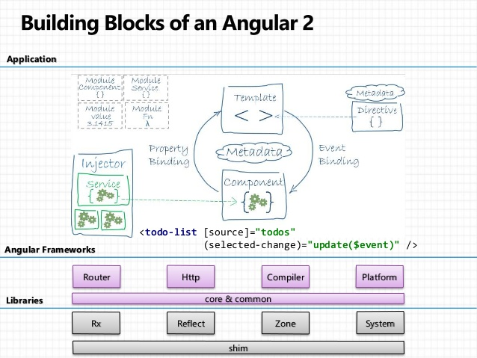
Angular Introduction
Angular JS is an open source framework built over JavaScript. This framework was used to overcome obstacles encountered while working with Single Page applications. Also, testing was considered as a key aspect while building the framework. It was ensured that the framework could be easily tested.
TypeScript based open-source front-end web application platform
Angular 2 uses a hierarchy of components as its main architectural concept
The desktop development is much easier when mobile performance issues are handled first
Works well in modern browsers
Improved dependency injection – bindings make it possible for dependencies to be named
Reactive programming support using RxJS
Modularity – much core functionality has moved to modules, producing a lighter, faster core
Angular also includes the benefits of ES6:Lambdas
Iterators
For/Of loops
Python-style generators
Reflection
TypeScrips is recommended one, optionally its supports DART,JavaScript

Slide 7
Angular Benefits
Angular2/4 is 5x faster than AngularJS 1.x
Loose Coupling
Support for Web Components
Ease in Templating, Form Field Management, Routing
Server Side UI rendering
Modular approach
Native Mobile Support
Rich Tool Set Support
IDE
Build Management
Development Support
Debugging Tools (browser based)
Strong Static Typing
ECMA 5/6 Compatibility
Multi Language Support
TypeScript (Recommended)
Dart
JavaScript

Slide 8
Angular Building Blocks
Data Binding
Template
Service
Dependency Injection
Module
Component
Metadata
Directive

Slide 9
Micro Services
Pause for TypeScript

Slide 10
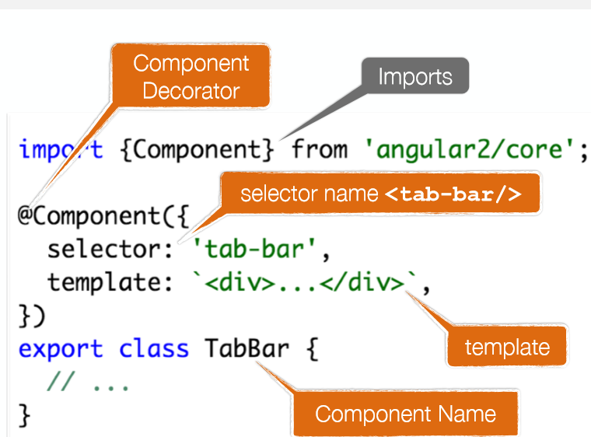
Angular.io
Angular 6 Components

Slide 11
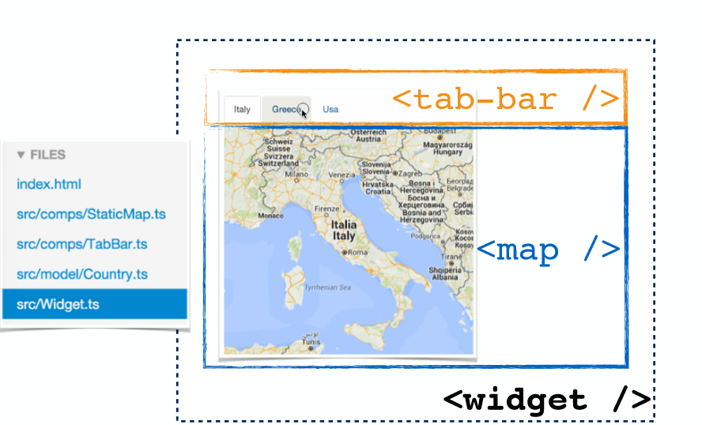
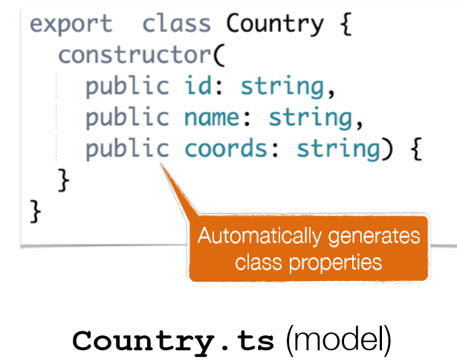
Angular.io
Angular 6 Components
http://plnkr.co/edit/vllrTYuOo6VJE7vMPEfQ?p=preview

Slide 12
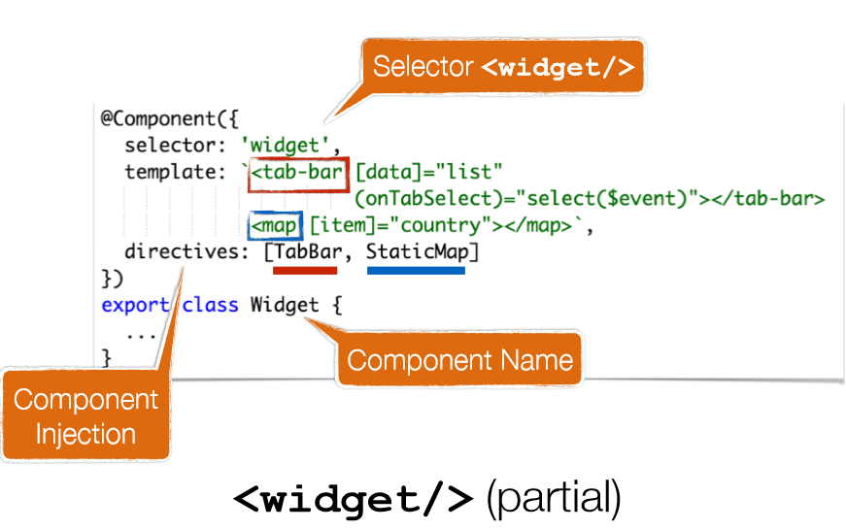
Angular.io
Angular 6 Components

Slide 13
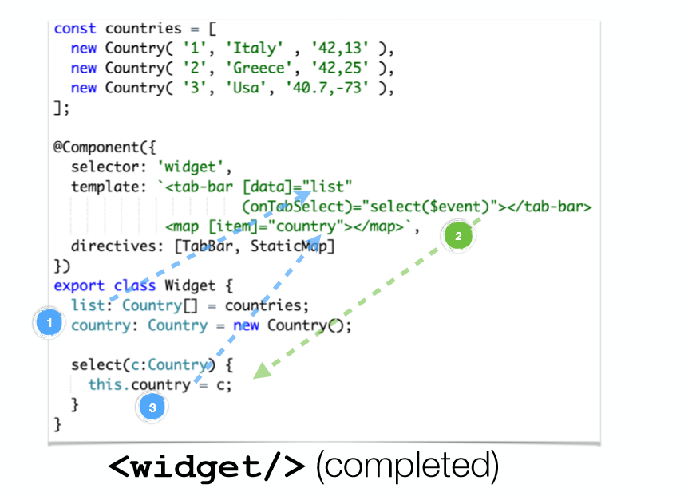
Angular.io
Angular 6 Components

Slide 14
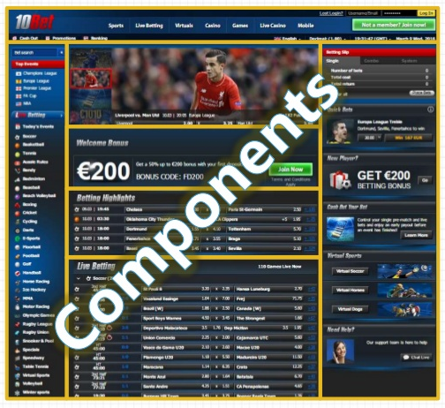
Angular.io
Angular 2 Components
Modules − This is used to break up the application into logical pieces of code. Each piece of code or module is designed to perform a single task.
Component − This can be used to bring the modules together.
Templates − This is used to define the views of an Angular JS application.
Metadata − This can be used to add more data to an Angular JS class.
Service − This is used to create components which can be shared across the entire application.
RS

Slide 15

Angular.io
Angular 2 Environment Setup
Install Node.js® and npm if they are not already on your machine.
Install AngularJS
Create a new project
Start the application
Verify that you are running at least node 6.9.x and npm 3.x.x by running node -v and npm -v in a terminal/console window. Older versions produce errors, but newer versions are fine.
$ npm install –g @angular/cli
$ ng new my-app
$ cd my-app
$ ng serve --open
Output in the Default
Browser:-

Slide 16
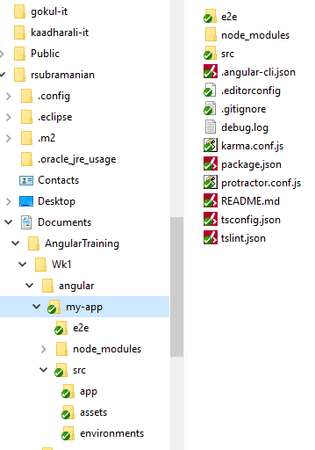
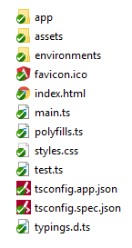
Angular.io
Angular 2 Project Folder Setup
Project Structure create by ng package
Project is compatable with IDE such as NodePad++, Atom, Sublime etc
Points to Note:-
Package.json → Has details about 3rd Party Packasges, and Custom Scripts
tsconfig.json → TypeScript compiler configuration for your IDE
tslint.json → Linting configuration for TSLint together with Codelyzer (when ng lint)
karma.conf.js → Unit test configuration for the Karma test runner, used when running ng test
E2e/ → which has e2e test cases.
node_modules → place where all dependent packages are stored in a recursive fashion.
environments/* → For maintaining env specific configurations.
assets/* → A folder where you can put images and anything else to be copied wholesale when you build your application.
index.html → main html file where all js/css files are linked (at runtime)
main.ts → entry point for the application

Slide 17
Angular.io
Angular 2 Sample Code Base
app.module.ts
app.component.ts
@NgModule({
declarations: [
AppComponent
],
imports: [
BrowserModule
],
providers: [],
bootstrap: [AppComponent]
})
import { Component } from '@angular/core';
@Component({
selector: 'app-root',
templateUrl: './app.component.html',
styleUrls: ['./app.component.css']
})
export class AppComponent {
title = 'app';
}
c
a
index.html
<!doctype html>
<html lang="en"><head>
<title>MyApp</title>
<base href="/">
<meta name="viewport" content="width=device-width, initial-scale=1"> <link rel="icon" type="image/x-icon" href="favicon.ico">
</head>
<body>
<app-root></app-root>
</body>
</html>
app.component.html
<h1> Welcome to {{title}}!! </h1>
<h2>Here are some links to help you start: </h2>
b

Slide 18
Micro Services
Data Binding

Slide 19
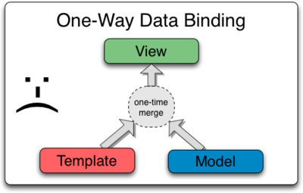
Data Binding / interpolation – One Way

Slide 20
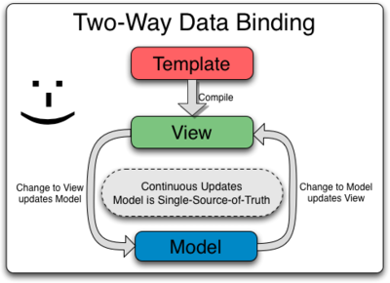
Data Binding / interpolation – 2 Way Binding

Slide 21
Data Binding / interpolation
….the insertion of something of a different nature into something else.

Slide 22
Data Binding / interpolation
import { Component } from '@angular/core';
@Component({
selector: 'app-root',
template: `
<h1>{{title}}</h1>
<h2>My favorite hero is: {{myHero}}</h2>
`
})
export class AppComponent {
title = 'Tour of Heroes';
myHero = 'Windstorm';
}

Slide 23
Data Binding / interpolation – via Constructor
export class AppCtorComponent {
title: string;
myHero: string;
constructor() {
this.title = 'Tour of Heroes';
this.myHero = 'Windstorm';
}
}

Slide 24
Data Binding / interpolation – 2 Way Binding
<input [(ngModel)]="username">
<p>Hello {{username}}!</p>
OR
<input [value]="username" (input)="username = $event.target.value">
<p>Hello {{username}}!</p>
[value]=”username” - Binds the expression username to the input element’s value property
(input)=”expression” - Is a declarative way of binding an expression to the input element’s input event (yes there’s such event)
username = $event.target.value - The expression that gets executed when the input event is fired
$event - Is an expression exposed in event bindings by Angular, which has the value of the event’s payload

Slide 25
Data Binding / interpolation – 2 Way Binding
<input [ngModel]="username" (ngModelChange)="username = $event">
<p>Hello {{username}}!</p>
The property binding [ngModel] takes care of updating the underlying input DOM element.
The event binding (ngModelChange) notifies the outside world when there was a change in the DOM.
ngModelChange takes care of extracting target.value from the inner $event payload

Slide 26
Data Binding / interpolation – Custom 2 Way Binding
app/counter.component.ts
export class CounterComponent {
@Input() count = 0;
@Output() countChange = EventEmitter<number>();
increment() {
this.count++;
this.countChange.emit(this.count);
}
}
app/counter.component.html
<div>
<p>
Count: {{ count }} -
<button (click)="increment()">Increment</button>
</p>
</div>

Slide 27
Data Binding / interpolation – NGFor*
export class AppComponent {
title = 'Tour of Heroes';
heroes = ['Windstorm', 'Bombasto', 'Magneta', 'Tornado'];
myHero = this.heroes[0];
}
template: `
<h1>{{title}}</h1>
<h2>My favorite hero is: {{myHero}}</h2>
<p>Heroes:</p>
<ul>
<li *ngFor="let hero of heroes">
{{ hero }}
</li>
</ul>
`

Slide 28
Data Binding / interpolation – NgIf*
<p *ngIf="heroes.length > 3">There are many heroes!</p>

Slide 29

Micro Services

Slide 30
Micro Services
Event Handling

Slide 31
Event handling
Clickmessage(){}
Form Control(s)
Event:On Click
Event:On Select
onChange(){}
event
<button (click)="onClickMe()">Click me!</button>
{{clickMessage}}
export class ClickMeComponent {
clickMessage = '';
onClickMe() {
this.clickMessage = 'You are my hero!';
}
}

Slide 32
Event handling
<input (keyup)="onKey($event)">
<p>{{values}}</p>
export class KeyUpComponent_v1 {
values = '';
onKey(event: any) { // without type info
this.values += event.target.value + ' | ';
}
}
The properties of an $event object vary depending on the type of DOM event. For example, a mouse event includes different information than an input box editing event.

Slide 33
Event handling – with Proper Data Type
<input (keyup)="onKey($event)">
<p>{{values}}</p>
export class KeyUpComponent_v1 {
values = '';
onKey(event: KeyboardEvent) { // with type info
this.values += (<HTMLInputElement>event.target).value + ' | ';
}
}
The $event is now a specific KeyboardEvent.

Slide 34
Event handling – with “Template Reference Variable”
@Component({
selector: 'app-key-up2',
template: `
<input #box (keyup)="onKey(box.value)">
<p>{{values}}</p>
`
})
export class KeyUpComponent_v2 {
values = '';
onKey(value: string) {
this.values += value + ' | ';
}
}
The template reference variable named box, declared on the <input> element, refers to the <input> element itself. The code uses the box variable to get the input element's value and display it with interpolation between <p> tags.

Slide 35
Event handling – with “Template Reference Variable” (Key Event Filter)
@Component({
selector: 'app-key-up3',
template: `
<input #box (keyup.enter)="onEnter(box.value)">
<p>{{value}}</p>
`
})
export class KeyUpComponent_v3 {
value = '';
onEnter(value: string) { this.value = value; }
}

Slide 36
Event handling – with “Template Reference Variable” (Multi Event Handling)
@Component({
selector: 'app-key-up4',
template: `
<input #box
(keyup.enter)="update(box.value)"
(blur)="update(box.value)">
<p>{{value}}</p>
`
})
export class KeyUpComponent_v4 {
value = '';
update(value: string) { this.value = value; }
}

Slide 37
Event handling – with “Template Reference Variable” - Observations
Use template variables to refer to elements
Pass values, not elements
Keep template statements simple

Slide 38
Micro Services

Slide 39
Micro Services
LifeCycle Hooks

Slide 40
Life Cycle Hooks
Angular creates it, renders it, creates and renders its children, checks it when its data-bound properties change, and destroys it before removing it from the DOM.
Angular offers lifecycle hooks that provide visibility into these key life moments and the ability to act when they occur.

Slide 41
Life Cycle Hooks
export class PeekABoo implements OnInit {
constructor(private logger: LoggerService) { }
// implement OnInit's `ngOnInit` method
ngOnInit() { this.logIt(`OnInit`); }
logIt(msg: string) {
this.logger.log(`#${nextId++} ${msg}`);
}
}
No directive or component will implement all of the lifecycle hooks.
Angular only calls a directive/component hook method if it is defined.

Slide 42
Life Cycle Hooks
ngOnChanges() | Respond when Angular (re)sets data-bound input properties.
ngOnInit() | Initialize the directive/component after Angular first displays the data-bound properties and sets the directive/component's input properties.
ngDoCheck() | Detect and act upon changes that Angular can't or won't detect on its own. Called during every change detection run, immediately after ngOnChanges() and ngOnInit().
ngOnDestroy() | Cleanup just before Angular destroys the directive/component. Unsubscribe Observables and detach event handlers to avoid memory leaks. Called just before Angular destroys the directive/component.
Other Hooks :- ngAfterContentInit() ngAfterContentChecked() ngAfterViewInit() ngAfterViewChecked()

Slide 43
Micro Services

Slide 44
Micro Services
Services and Dependency Injection

Slide 45
Services and DI
Service is a broad category encompassing any value, function, or feature that an app needs.
DI framework provides declared dependencies to a class when that class is instantiated.

Slide 46

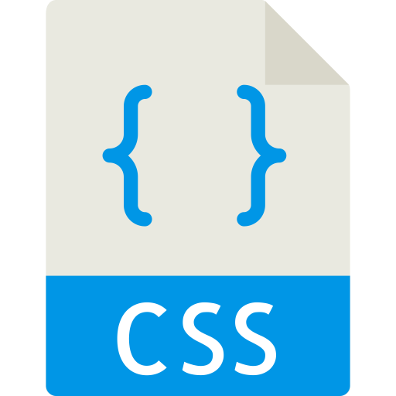
Services and DI
Dependency
Injection
@Injectable
LoggerService
@Component
Component
constructor(loggerService,heroService)
@Injectable ExceptionService
Dependency
Injection
@Injectable HeroService
Dependency
Injection
`
[Declarations]
[providers]
[providers]
[providers]
@NGModule

Slide 47
Services and DI
A service is typically a class with a narrow, well-defined purpose. For example LoggerService, HttpClientService, DataTransformationService
Angular creates a single, shared instance of LoggerService and injects it into any class that asks for it
Makes the component layer more leaner and improved manageability.
Supports Contract based Implementation using Interfaces.

Slide 48
Services and DI – Service Definition
src/app/logger.service.ts
@Injectable()
export class Logger {
log(msg: any) { console.log(msg); }
error(msg: any) { console.error(msg); }
warn(msg: any) { console.warn(msg); }
}

Slide 49
Services and DI – Service Injection –Option 1
src/app/hero-list.component.ts
@Component({
selector: 'app-hero-list',
templateUrl: './hero-list.component.html',
providers: [ LoggerService ]
})

Slide 50
Services and DI – Service Injection –Option 2
src/app/hero-list.component.ts
constructor(private service: LoggerService) { }

Slide 51
Services and DI – Service Injection – to a given Module
src/app/app-module.ts
@NgModule({
providers: [
BackendService,
LoggerService
],
...
})}

Slide 52
Services and DI – Service Injection – Injectable Decorator
import { Injectable } from '@angular/core'; @Injectable({ providedIn: 'root', }) export class UserService {} | 'root’ → injectable will be registered as a singleton in the application, & not required to add it to the providers of the root module.
import { Injectable } from '@angular/core'; import { UserModule } from './user.module'; @Injectable({ providedIn: UserModule, }) export class UserService {} | The Service is available only the module “UserModule”
import { NgModule } from '@angular/core'; import { UserService } from './user.service'; @NgModule({ providers: [UserService], }) export class UserModule {} | The Service is available only the module “UserModule”

Slide 53
Micro Services
NGModule

Slide 54
NgModules
@NgModule
NgModules are containers for a cohesive block of code dedicated to an application domain, a workflow, or a closely related set of capabilities

Slide 55
NgModules –Meta Data →Sample Code Snippet
@NgModule({
declarations: [
AppComponent,
ItemDirective
],
imports: [
BrowserModule,
FormsModule,
HttpClientModule
],
export:[],
providers: [],
bootstrap: [AppComponent]
})
export class AppModule { }

Slide 56
NgModules –Meta Data →Declarations
The components, directives, and pipes that belong to this NgModule.

Slide 57
NgModules –Meta Data →exports
The subset of declarations that should be visible and usable in the component templates of other NgModules.

Slide 58
NgModules –Meta Data →imports
Other modules whose exported classes are needed by component templates declared in this NgModule.

Slide 59
NgModules –Meta Data →Providers
Creators of services that this NgModule contributes to the global collection of services; they become accessible in all parts of the app. (You can also specify providers at the component level, which is often preferred.)

Slide 60
NgModules –Meta Data →bootstrap
The main application view, called the root component, which hosts all other app views. Only the root NgModule should set the bootstrap property.

Slide 61
NgModules – Hierarchy
NGModule
Component 1
Embed Component
Embed Component
Component 2
Embed Component
Service
Directive
Pipe

Slide 62
NgModules – Importing other Modules (Feature Modules)
@NgModule({
declarations: [
AppComponent
],
imports: [
BrowserModule,
FormsModule,
HttpClientModule,
CustomerDashboardModule
],
providers: [],
bootstrap: [AppComponent]
})
export class AppModule { }
NGModule
Core Modules
Feature Modules
Browser Module
Forms Module
HTTP Client Module
Dashboard Module
Funds Transfer Module
User Profile Module

Slide 63
NgModules – Importing other Modules (Feature Modules)
$> ng generate module CustomerDashboard

Slide 64
Micro Services
Template

Slide 65
Template
HTML is the language of the Angular template
manages what the user sees and can do

Slide 66
Template
@Component({
selector: 'app-root',
templateUrl: './app.component.html',
styleUrls: ['./app.component.css']
})
export class AppComponent {
title = 'My First Angular App!';
}

Slide 67
Template Instances
Interpolation in line with HTML elements
<h3> {{title}}
<img src="{{heroImageUrl}}" style="height:30px">
</h3>
Evaluation
<p>The sum of 1 + 1 is {{1 + 1}}</p>
Evaluation + Invoke Methods
<p>The sum of 1 + 1 is not {{1 + 1 + getVal()}}</p>

Slide 68
Template Instances
Interpolation with Iteration
<div *ngFor="let hero of heroes">{{hero.name}}</div>
<input #heroInput> {{heroInput.value}}
Event Handing with Iteration
<button (click)="onSave($event)">Save</button>
<button *ngFor="let hero of heroes" (click)="deleteHero(hero)">{{hero.name}}</button>
<form #heroForm (ngSubmit)="onSubmit(heroForm)"> ... </form>

Slide 69
Micro Services
Pipes

Slide 70
Pipes
a way to write display-value transformations that you can declare in your HTML.
Places of Usage:-
Data Transformation
Data Filtering
In line formatting
Custom Localization

Slide 71
Pipes – Built In
import { Component } from '@angular/core';
@Component({
selector: 'app-hero-birthday',
template: `<p>The hero's birthday is {{ birthday | date }}</p>`
})
export class HeroBirthdayComponent {
birthday = new Date(1988, 3, 15); // April 15, 1988
}

Slide 72
Pipes – Built In with Parametrization
<p>The hero's birthday is {{ birthday | date:"MM/dd/yy" }} </p>

Slide 73
Pipes – Built In with Parametrization(w) expression
template: `
<p>The hero's birthday is {{ birthday | date:format }}</p>
<button (click)="toggleFormat()">Toggle Format</button>
export class HeroBirthday2Component {
birthday = new Date(1988, 3, 15); // April 15, 1988
toggle = true; // start with true == shortDate
get format() { return this.toggle ? 'shortDate' : 'fullDate'; }
toggleFormat() { this.toggle = !this.toggle; }
}

Slide 74
Pipes – Chaining
The chained hero's birthday is
{{ birthday | date | uppercase}}
The chained hero's birthday is
{{ birthday | date:'fullDate' | uppercase}}

Slide 75
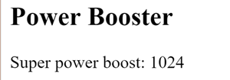
Pipes – Custom Developed Pipes
Pipe Definition:-
import { Pipe, PipeTransform } from '@angular/core’;
@Pipe({name: 'exponentialStrength'})
export class ExponentialStrengthPipe implements PipeTransform {
transform(value: number, exponent: string): number {
let exp = parseFloat(exponent);
return Math.pow(value, isNaN(exp) ? 1 : exp);
}
}
Pipe Usage:-
import { Component } from '@angular/core';
@Component({
selector: 'app-power-booster',
template: `
<h2>Power Booster</h2>
<p>Super power boost: {{2 | exponentialStrength: 10}}</p>`
})
export class PowerBoosterComponent { }

Slide 76
Pipes – Pure vs Im-Pure Pipes
Pure | Impure
Default Setting
Executes when change to a primitive input value (String, Number, Boolean, Symbol) or a changed object reference | Executes an impure pipe during every component change detection cycle. An impure pipe is called often, as often as every keystroke or mouse-move.
Faster & generally preferred
@Pipe({
name: 'flyingHeroesImpure',
pure: false
})
export class FlyingHeroesImpurePipe extends FlyingHeroesPipe {}

Slide 77
Async Pipes – Im-Pure Pipes
@Component({
selector: 'app-hero-message',
template: `
<h2>Async Hero Message and AsyncPipe</h2>
<p>Message: {{ message$ | async }}</p>
<button (click)="resend()">Resend</button>`,
})
export class HeroAsyncMessageComponent {
message$: Observable<string>;
private messages = [
'You are my hero!',
'You are the best hero!',
'Will you be my hero?'
];
constructor() { this.resend(); }
resend() {
this.message$ = interval(500).pipe(
map(i => this.messages[i]),
take(this.messages.length)
);
}
}
The AsyncPipe accepts a Promise or Observable as input and subscribes to the input automatically, eventually returning the emitted values
The AsyncPipe is also stateful.
The pipe maintains a subscription to the input Observable and keeps delivering values from that Observable as they arrive

Slide 78
Micro Services
Promise and Observable

Slide 79

Promise & Observable
Promise, in Javascript, is a concept which allows the callee function to send back a promise (sort of assurance) to the caller function that it would, for sure, send back a resolution, be it a success or a failure at a little later point of time.
The caller believes the callee if a promise is sent back, and, proceeds ahead with the program execution.

Slide 80
Why Promise..in a nutshell
Allows asynchronous operations to happen; Caller can proceed ahead with program execution if callee function returned a promise object.

Slide 81
Callbacks
function doAsyncTask(cb) {
setTimeout(() => {
console.log("Async Task Calling Callback");
cb();
}, 1000);
}
doAsyncTask(() => console.log("Callback Called"));
The doAsyncTask function when called kicks of an asynchronous task and returns immediately.

Slide 82
Creating a Promise
var promise = new Promise((resolve, reject) => {
})
We pass to Promise an inner function that takes two arguments (resolve, reject).
Since we are defining the function we can call these arguments whatever we want but the convention is to call them resolve and reject.
resolve and reject are in fact functions themselves.
Inside this inner function we perform our asynchronous processing and then when we are ready we call resolve(), like so:

Slide 83
Creating a Promise
var promise = new Promise((resolve, reject) => {
})
function doAsyncTask() {
var promise = new Promise((resolve, reject) => {
setTimeout(() => {
console.log("Async Work Complete");
if (error) {
reject();
} else {
resolve();
}
}, 1000);
});
return promise;
}

Slide 84
Creating a Promise Notifications
We can get notified when a promise resolves by attaching a success handler to its then function, like so
doAsyncTask().then(() => console.log("Task Complete!"));

Slide 85
Creating a Promise Notifications
then can take two arguments, the second argument is a error handler that gets called if the promise is rejected, like so:
doAsyncTask().then(
() => console.log("Task Complete!"),
() => console.log("Task Errored!"),
);

Slide 86
Why Promise
Allows asynchronous operations to happen; Caller can proceed ahead with program execution if callee function returned a promise object.

Slide 87
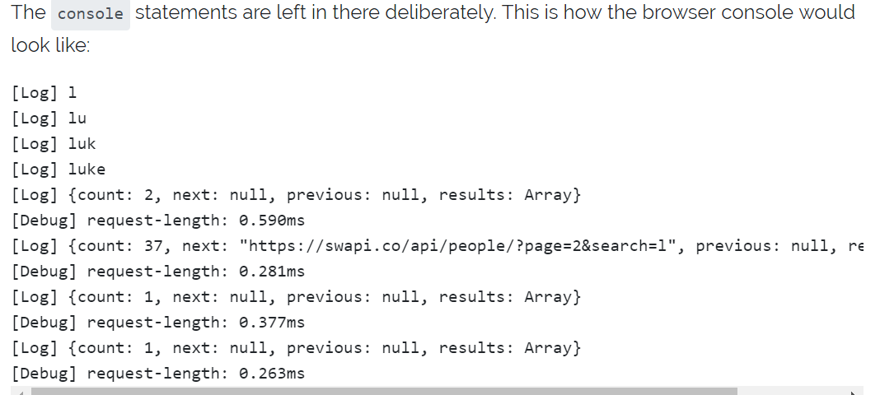
Why Promise. In Action
<div>
<h2>Star Wars Character Search</h2>
<input #term type="text" (keyup)="search(term.value)">
<hr>
<div *ngIf="results.length > 0">
<li *ngFor="let result of results">{{ result.name }} is a character with a height of {{ result.height }}.</li>
</div>
</div>
constructor(private http: HttpClient) { }
private search(term) {
console.log(term);
this.http.get(`https://swapi.co/api/people/?search=${term}`).toPromise()
.then((data: any) => {
/* tslint:disable:no-console */
console.time('request-length');
console.log(data);
console.timeEnd('request-length');
this.results = data.results;
})
.catch(this.handleError);
}

Slide 88
Promise
promises is that a request initiated from a promise is not cancellable

Slide 89
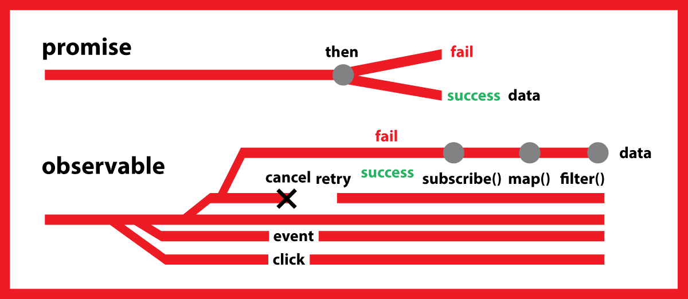
Observables
An observable is essentially a stream (a stream of events, or data) and compared to a Promise,
an Observable can be cancelled. It out of the box supports operators such as map() and filter()

Slide 90
Observables
ngOnInit() {
this.term.valueChanges
.debounceTime(400)
.distinctUntilChanged()
.subscribe(searchTerm => {
this.http.get(`https://swapi.co/api/people/?search=${searchTerm}`).subscribe((data: any) => {
/* tslint:disable:no-console */
console.time('request-length');
console.log(data);
console.timeEnd('request-length');
this.results = data.results;
});
});
}

Slide 91
Observables
Map | Http.get('/someUrl') .map(rese => res.json().data) .map(data => ({data: data.value*10}) .subscribe(result => {this.view = result;}); The first chain uses one http call, after multiple the response to 10 and assign the result to a view variable that is used to render
SwitchMap | Http.get('/someUrl') .map(rese => res.json().data) .switchMap(data => Http.get(`/otherUrl/${data.value}`)) .subscribe(result => {this.view = result;});
ForkJoin | Observable.forkJoin( Http.get('/someUrl').map(res => res.json().data), Http.get('/otherUrl').map(res => res.json().data), (data1, data2) => ({data1, data2}) ).subscribe(data => {this.view = `${data.data1} - ${data.data2}`;});
Empty | Http.get('/someUrl').map(res => res.json().data) .switchMap(result => result.value >0 ? Observable.of(result) : Observable.empty() ).switchMap(() => Http.get('/otherUrl').map(res => res.json().data)};
Reject | Observable.throw('Error')

Slide 92
Observables
Catch | Observable.throw('Error') .catch(err => { console.log(err); return Observable.empty(); });
Finally | Http.get('/someUrl').map(res => res.json().data) .catch(err = > { console.log(err);}) .finally(()=> stopLoader());

Slide 93
Micro Services
Routes and Navigation

Slide 94
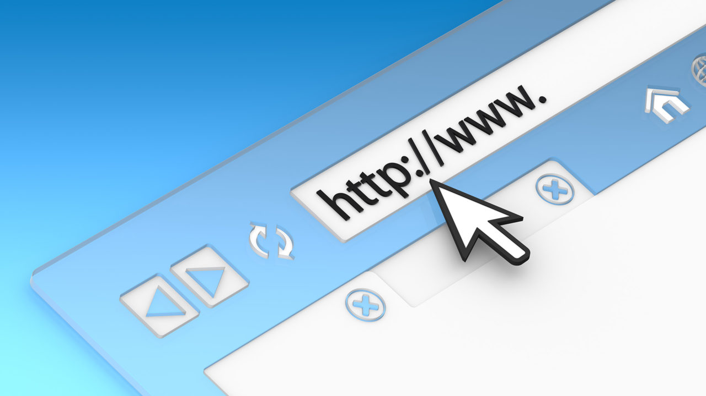
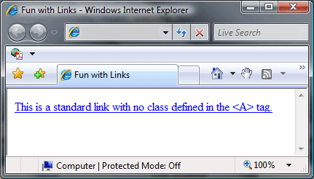

Routes and Navigation
Angular Router enables navigation from one view to the next as users perform application tasks
URL in the address bar | Click links on the page | Click the browser's back and forward buttons

Slide 95
Routes and Navigation
const appRoutes: Routes = [
{ path: 'crisis-center', component: CrisisListComponent },
{ path: 'hero/:id', component: HeroDetailComponent },
{
path: 'heroes',
component: HeroListComponent,
data: { title: 'Heroes List' }
},
{ path: '',
redirectTo: '/heroes',
pathMatch: 'full'
},
{ path: '**', component: PageNotFoundComponent }
];
Pass the appRoutes to RouterModule.forRoot method
in the module imports to configure the router.
Order
of
route
mapping
@NgModule({
imports: [
RouterModule.forRoot(
appRoutes,
{ enableTracing: true } // <-- debugging purposes only
)
// other imports here
],
...
})

Slide 96
Routes – Router Link
<h1>Angular Router</h1>
<nav>
<a routerLink="/crisis-center" routerLinkActive="active">Crisis Center</a>
<a routerLink="/heroes" routerLinkActive="active">Heroes</a>
</nav>
<router-outlet></router-outlet>
The RouterOutlet is a directive from where the router should display the components for that outlet.

Slide 97
Routes – Route Guard(s)
Angular’s route guards are interfaces which can tell the router whether or not it should allow navigation to a requested route.
Based on decision the controls goes to next route.
This is helpful in places where following aspects are required.
Authorization
Pre Conditions Check
Route level logging/Auditing
Any further horizontal cross cutting concerns
Route 1
Route 2
(OnClick):RouerLink
Can-activate
If (true)
If (false)
{pre-check logic}
Service calls
Repo calls

Slide 98
Routes – Router Pre Verification – Can-Activate
const appRoutes: Routes = [
{ path: 'crisis-center', component: CrisisListComponent },
{ path: 'hero/:id', component: HeroDetailComponent, canActivate: [AuthGuard] },
{ path: ‘’, redirectTo: '/heroes', pathMatch: 'full'},
{ path: '**', component: PageNotFoundComponent }
];
@Injectable()
export class AuthGuard implements CanActivate {
canActivate(next: ActivatedRouteSnapshot, state: RouterStateSnapshot): Observable<boolean> | Promise<boolean> | boolean {
if (this._authService.isAuthenticated()) {
return true;
}
// navigate to login page
this._router.navigate(['/login']);
// you can save redirect url so after authing we can move them back to the page they requested
return false;
}
}

Slide 99
Routes – Other Routes
Route Name | Purpose
CanActivate | True→ Navigation will continue, False → Navigation will be cancelled. Or to any returned urltree object
CanActivateChild | Same as CanActivate, but applies to Child route
CanDeactivate | To check for user confirmation before proceeding or not with the stated route.
Resolve | To have an intermediate code to be executed before loading the stated component
CanLoad | To mediate navigation to a feature module loaded asynchronously

Slide 100
Routes – Navigating by Predefined URL(s)
<nav class="navbar navbar-light bg-faded">
<a class="navbar-brand" href="/#/">iTunes Search App</a>
<ul class="nav navbar-nav">
<li class="nav-item active">
<a class="nav-link" href="/#/">Home</a> (1)
</li>
<li class="nav-item">
<a class="nav-link" href="/#/search">Search</a>
</li>
</ul>
</nav>

Slide 101
Routes – Navigating by Router API
class HeaderComponent {
constructor(private router: Router) {}
goHome() {
this.router.navigate(['']);
}
goSearch() {
this.router.navigate(['search']);
}
}

Slide 102
Routes – Navigating by Router API with Data
class HeaderComponent {
constructor(private router: Router) {}
goSearch() {
let part = "foo";
this.router.navigate(['search', part, 'moo']);
}
}

Slide 103
Routes – Router Outlet
Type | Router Outlet Syntax
Default | <router-outlet></router-outlet>
Named Router Outlet | <router-outlet name="outlet1"></router-outlet>

Slide 104
Routes – Router Outlet – Default (Layout)
Logo | Link1 Link2 Link3 | User Profile
<router-outlet></router-outlet>
Footer

Slide 105
Routes – Router Outlet – Default (Layout)
Logo | Link1 Link2 Link3 |  | User Profile
<router-outlet name=‘sidebar’></router-outlet> |  | <router-outlet name=‘contentarea’></router-outlet> |  | <router-outlet name=‘floatingmenu’></router-outlet>
Footer

Slide 106

Micro Services

